Slide 1
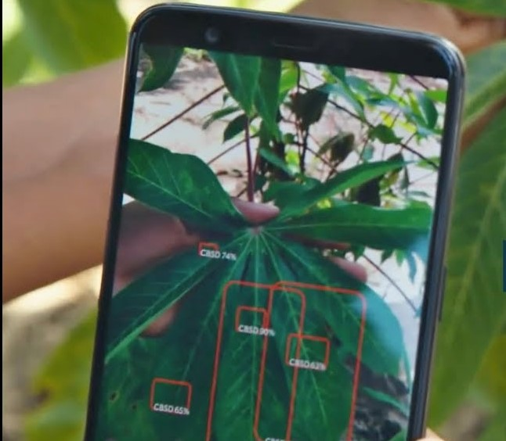
Application for Plant Disease Detection (LeDiTor)
Submitted by:
Sumit Tiwari
DD1711303024
B.Tech CSE
Guided by-> Mr. Yogesh Pant

Slide 2
Project Brief:
An android application which takes user input image through camera sensor and after analyzing it give the disease (if any) of the plant to user.
Plant disease identification by visual way is more laborious task and at the same time less accurate and can be done only in limited areas.
Whereas if automatic detection technique is used it will take less efforts, less time and more accurately. In plants, some general diseases are brown and yellow spots, or early and late scorch, and other fungal, viral and bacterial diseases.

Slide 3
Application Structure
Application
Input – Images from user (Either from gallery or by live camera sample)
Output – Image is classified into different cluster and then result the cluster name to the user.
Processing – Image is extracted and matched with pre-trained model

Slide 4
What we have done?
Collected approx 45+ different datasets of different disease
Used them to train some basic clusters with the help of CNN and upgrade them by transfer learning.
Save a Keras model to TF-Lite model using TFLiteConvertor so that it can be used in application to predict the output.

Slide 5
Benefits with this application:
Any interested person can directly scan the leaf and can find out the disease of a plant.
Project can be used by farmers who can’t afford the proper facility but by the help of just a simple app they can easily get to know about their plant health.
If we find out the proper disease than the proper treatment can be done.
Project is flexible as the number of dataset increases its precision increases.

Slide 6
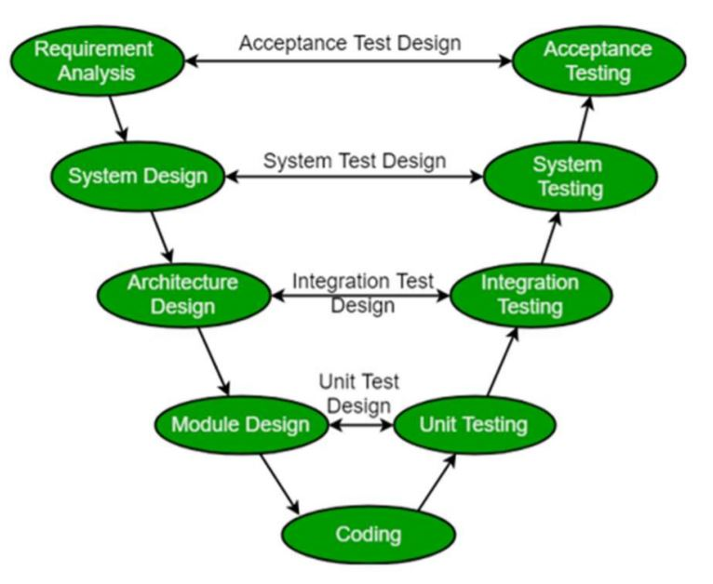
Process Model
The Software Development Life Cycle (SDLC) model used in this project is Iterative V – Model

Slide 7
Modules in the Project (in brief)
Camera / Upload
This module will provide the user to click the photo or they can upload the image of the leaf or the plant to get the details.
This section contains part of the native android.
First the image will be uploaded and being processed on the client side to verify the image to predict its class. The prediction of the image will use the concept of machine learning and image processing. In the process of prediction, the very first step is to convert the image into the size on which our machine is trained for the dataset. Then the image is set to its color mode according to the trained dataset. Then the image will be passing on to the machine (trained dataset code) and it will return the image class as the output of the image. Getting the ‘id’ of the image class the leaf will be identified and its disease details will be displayed to the user.

Slide 8
Brief about requirements
Plant Dataset is the only major requirement of the project.
Dataset Overview Source: Self Collected and Kaggle.com
Pepper bell Bacterial spot
Pepper bell healthy.
Potato Early curse
Potato Late curse
Potato solid
Tomato Bacterial spot
Tomato Early scourge
Tomato Late scourge
Tomato Leaf , etc
Size, Format& No. of images:
16.5 Kb, (.JPEG Format), 1000+ images in each Folder.
Other than that the small requirements are :
different libraries of python,
Keras applications for transfer learning,
Tensorflow and Cuda library for graphical content,
a text editor,
A testing device, etc.

Slide 9
Minimum Software Requirements (Front End and Back End)
Requirements for running the application:
Android 2.3 and above
Camera compatible device
Gallery app for using previous images(optional).
Requirements for development purpose:
Language – Python(Phase 1), Java(Phase 2)
IDE– Jupyter Notebook(Phase 1), Android Studio(Phase 2)
Library /Framework– Tensorflow, MobileNetV2, Cuda, Numpy, MatPlotLib, Keras (Phase 1), Android(Phase 2)

Slide 10
Minimum Hardware Requirements
Requirements to run this application:
An android device with android 2.3 and above and having camera sensor.
One time internet connection for download purpose
Requirement recommended for development purpose:
Intel core i5/i7/i9 or AMD Ryzen 5/7 processor
Nvdia GTX/RTX 10/20 series graphic card
Nvidia CUDA libraries
Ram- 8/16GB
Android Device for testing purpose
Regular internet connectivity of 2MBps

Slide 11
Scope of the Project
A country’s economy is very much dependent on its agricultural productivity. Thus, the detection of diseases in plants holds an importance for the product quality and productivity. Sometimes, these diseases are hazardous, for example little leaf disease in pine trees in United States. Hence, automatic detection of plant diseases is required for early stage detection as well as it reduces manual monitoring work in big farms. The previous research on this filed has been limited as it involves human intervention.

Slide 12
Further Scope
The application can be further extended by implementing database which store details of the diseased plant and how it can be cured, also a module which suggest the early symptoms so that the farmers can prevent there crops from disease and loss can be minimized.

Slide 13
Project…

Slide 14
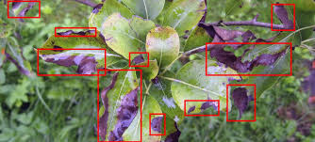
That’s all for the session

Slide 15
Thank You…

